Slide 1
PRODUCT NAME: INVENTORY MANAGEMENT APP
Product Vision
Empower small-scale businesses in Nigeria to optimize their inventory management, streamline operations, and drive growth through a user-friendly, automated, and data-driven platform."
Concise Description
Introducing Inventory Management App, a simple and affordable inventory management solution designed specifically for small-scale businesses in Nigeria. Our app helps entrepreneurs:
Track stock levels in real-time
Automate inventory tracking and reporting
Set alerts for low stock and expiration dates
Optimize storage and reduce waste
Make data-driven decisions to improve profitability
With Inventory Management App, say goodbye to manual errors, stockouts, and overstocking. Take control of your inventory and focus on growing your business.

Slide 2
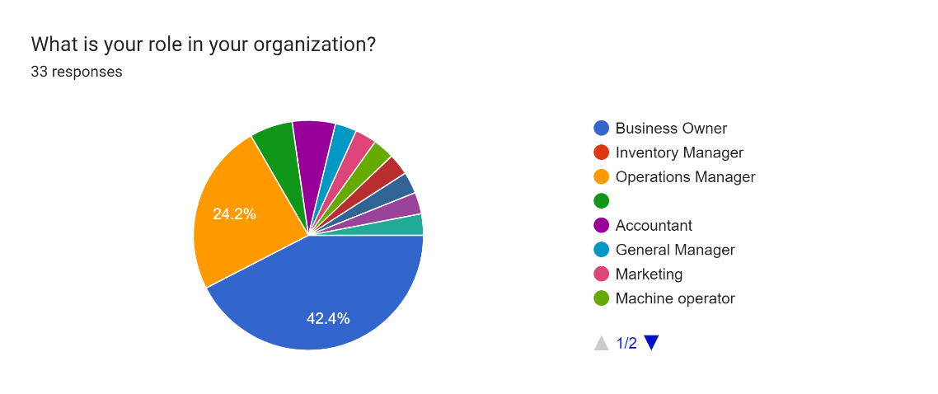
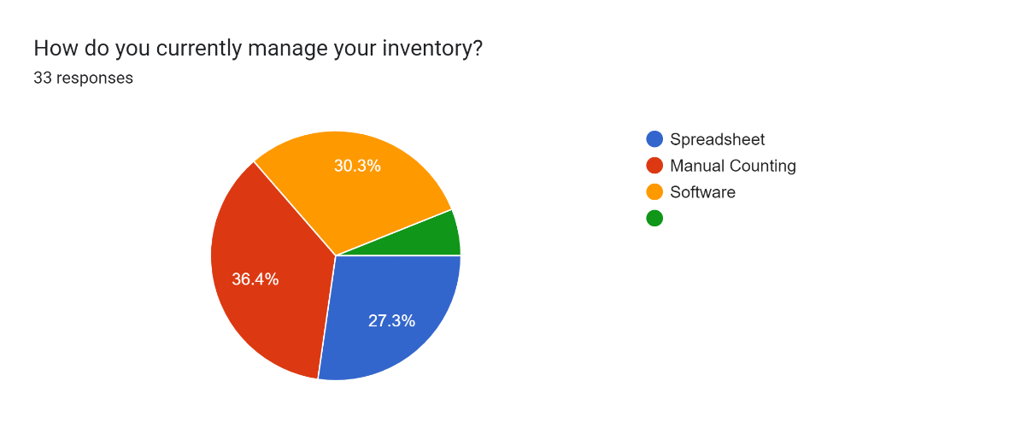
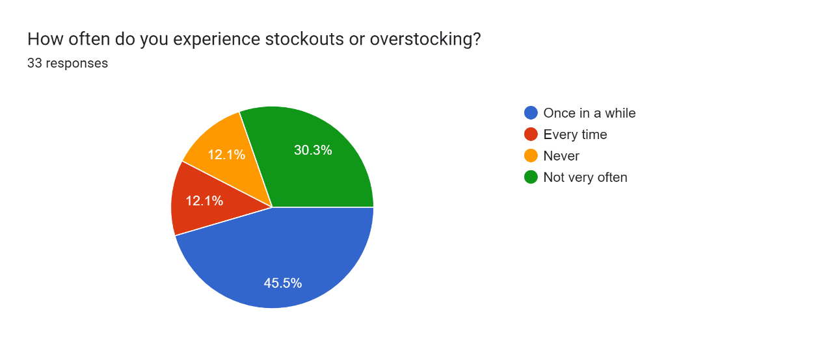
Summary and Analysis of Google Form & Empathy Maps Gathered
Forms response chart. Question title: What is your role in your organization?. Number of responses: 33 responses.
42.4% from this response are the business owners, meaning you're certain of more accurate answer, because they are directly affected.
Forms response chart. Question title: How do you currently manage your inventory?. Number of responses: 33 responses.
From this response, a larger percent of the people still engage in manual inventory counting, hence the need for an inventory management app
Forms response chart. Question title: How often do you experience stockouts or overstocking?. Number of responses: 33 responses.
From this response, only 12.1% never experience stockouts or overstocking, while 87.9 have a history of overstocking or stockouts, resulting in lost sales and revenue and overstocking resulting to holding excess stock, tying up capital and increasing storage costs. hence the need for an inventory management app

Slide 3
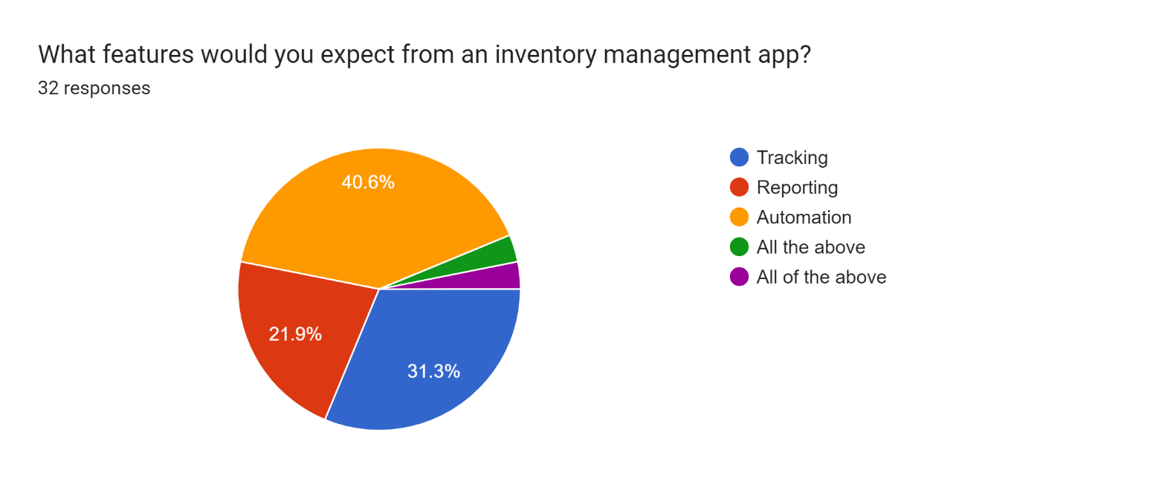
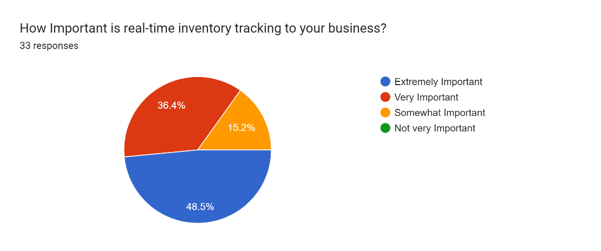
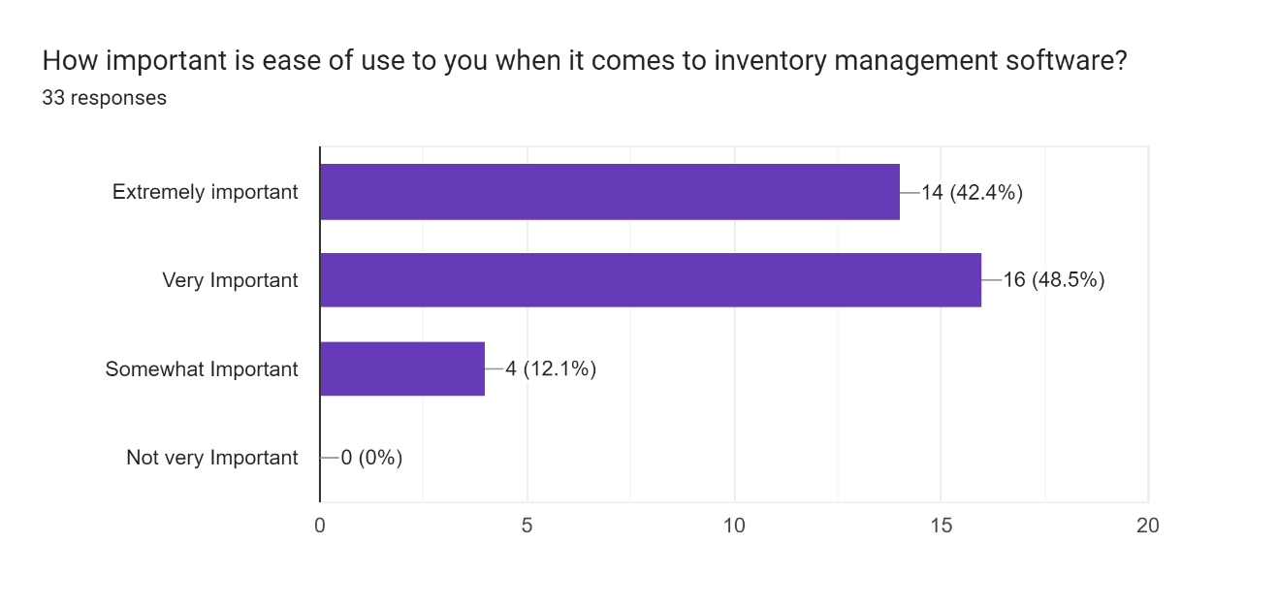
Summary and Analysis of Google Form & Empathy Maps Gathered
Forms response chart. Question title: What features would you expect from an inventory management app?. Number of responses: 32 responses.
Tracking, Automation and reporting are key features of an inventory management app
Forms response chart. Question title: How Important is real-time inventory tracking to your business?. Number of responses: 33 responses.
84.9%, which is above average, strongly accept that a real-time inventory tracking is extremely important to any business
Forms response chart. Question title: How important is ease of use to you when it comes to inventory management software?. Number of responses: 33 responses.
Again 90.9% agrees that they need an inventory management app that is easy to use making it easy to manage stock, so they can make informed decisions and improve their bottom line.

Slide 4

PROBLEM STATEMENT
Small-scale businesses in Nigeria struggle with inefficient inventory management, leading to:
Stockouts: Running out of stock, resulting in lost sales and revenue
Overstocking: Holding excess stock, tying up capital and increasing storage costs
Manual errors: Inaccurate tracking and reporting due to manual processes, leading to stock discrepancies and waste
Lack of visibility: Insufficient real-time insights into stock levels, making it difficult to make informed decisions
Inefficient operations: Wasting time and resources on manual inventory management, taking away from core business activities
These challenges result in:
Reduced profitability
Decreased customer satisfaction
Increased stress and workload for business owners
A user-friendly, automated, and data-driven inventory management solution is needed to address these challenges and empower small-scale businesses in Nigeria to optimize their inventory management, streamline operations, and drive growth."

Slide 5

SWOT ANALYSIS FOR INVENTORY MANAGEMENT
Weaknesses:
Internal Factor
Initial Setup & Maintenance Cost
Technical Issues
Complexity in staff Training/Learning Curve
Dependency on Technology
Customization Limits
Integration challenges
STRENGTHS:
Internal factors
Automation:
Real-time Tracking:
Integration
Data-driven decision-making
Scalability
Cost savings
Opportunities: External Factor
Growing E-commerce
Technological Advancement
Partnerships
Global Expansion
Growing demand for automation
Threats:
External Factor
Competition
Regulatory
Changes
Cybersecurity Risks
Economic Downturns
Changing Market Trends

Slide 6

USER PERSONA FOR THE INVENTORY MANAGEMENT PRODUCT
Name: Nneka
Age: 32
Occupation: Owner, Small Retail Business (Fashion)
Location: Lagos, Nigeria
Goals:
Efficiently manage inventory to avoid stockouts and overstocking
Reduce time spent on manual inventory tracking
Improve accuracy and visibility into stock levels
Make data-driven decisions to optimize business operations
Grow business while maintaining profitability
Pain Points:
Manual inventory tracking is time-consuming and prone to errors
Difficulty in keeping track of stock levels, leading to stockouts and overstocking
Limited visibility into inventory performance and trends
Inefficient use of storage space and resources
Difficulty in scaling business due to manual inventory management
Behavior Patterns:
Regularly checks inventory levels and updates records manually
Spends significant time on inventory management, taking away from core business activities
Relies on intuition and experience to make inventory decisions
Values ease of use, simplicity, and accuracy in an inventory management solution
Technology Comfort Level:
Familiar with basic computer skills and mobile apps
Open to adopting new technology to improve business operations
Prefers user-friendly and intuitive interfaces
Quote:
"I want to focus on growing my business, not getting bogged down in manual inventory tracking. I need a solution that makes it easy to manage my stock, so I can make informed decisions and improve my bottom line."
This user persona represents the target user for the Inventory Management product, highlighting their goals, pain points, behavior patterns, and technology comfort level. It helps guide the development of a solution that meets the needs and expectations of small business owners like Nneka.

Slide 7

A CONCISE OVERVIEW OF MY COMPETITIVE LANDSCAPE USING PORTER’S 5 FORCES
Porter's 5 Forces is a framework that helps businesses understand their competitive landscape. Here's how to utilize it
Threat of New Entrants: The threat of new entrants to an inventory management product is medium. Here's why:
High barriers to entry:
Moderate barriers to entry:
Low barriers to entry:
2. Bargaining Power of Suppliers: The bargaining power of suppliers to an inventory management product is low. Here's why:
Inventory management software typically relies on standard technologies and infrastructure (e.g., servers, databases, programming languages).
Suppliers of these technologies (e.g., Amazon Web Services, Microsoft) have limited bargaining power.
3. Bargaining Power of Buyers: The bargaining power of buyers to an inventory management product is medium. Here's why:
Buyers (businesses using inventory management software) have some bargaining power due to:
Moderate switching costs (time, money, and effort required to change software)
Availability of alternative solutions (competitors, open-source options)
Some buyers may have significant purchasing power (large enterprises)

Slide 8
4. Threat of Substitute Products or Services: Threat of substitute product or service to an inventory management product is low. Here's why:
Substitute products (manual inventory management, spreadsheets, or alternative software) are available but have limitations:
Manual methods are time-consuming, error-prone, and difficult to scale
Spreadsheets have limitations in terms of automation, integration, and collaboration
Alternative software may not offer the same features, quality, or support
5. Competitive Rivalry Among Existing Competitors: Competitive rivalry among existing competitors to an inventory management product is high. Here's why:
The inventory management software market is highly competitive, with many established players and new entrants: This intense competition leads to:
Aggressive marketing and sales tactics
Continuous product improvement
Pricing pressure
High customer acquisition and retention costs
SUMMARY
This concise overview helps to understand the competitive landscape and ultimately help to make informed strategic decisions.
Force | Score (High/Medium/Low)
Threat of New Entrants | Medium – (4/10)
Bargaining Power of Suppliers | Low – (2/10)
Bargaining Power of Buyers | Medium – (5/10)
Threat of Substitute Products | Low – (3/10)
Competitive Rivalry | High – (8/10)

Slide 9

THREE POTENTIAL COLLABORATORS FOR THE PRODUCT INVENTORY MANAGEMENT, ALONG WITH THE RATIONALE AND ANTICIPATED IMPACT
Collaborator 1: Shopify
Rationale: Shopify is a leading e-commerce platform with a vast user base of small to medium-sized businesses. Integrating Inventory Management with Shopify can expand its reach and provide a comprehensive solution for online retailers.
Anticipated Impact:
Increased user base and market share
Enhanced e-commerce capabilities
Streamlined inventory management for online retailers
Potential for co-marketing and cross-selling opportunities
Collaborator 2: QuickBooks
Rationale: QuickBooks is a popular accounting software used by many small businesses. Integrating Inventory Management with QuickBooks can provide a seamless financial management experience and enhance the overall value proposition.
Anticipated Impact:
Improved financial management capabilities
Enhanced accuracy and automation of financial data
Increased customer satisfaction and retention
Potential for co-marketing and cross-selling opportunities
Collaborator 3: FedEx/UPS
Rationale: FedEx and UPS are leading logistics providers that can enhance the inventory management experience by providing real-time shipping and tracking capabilities.
Anticipated Impact:
Improved shipping and logistics management
Enhanced supply chain visibility
Increased efficiency and reduced costs
Potential for co-marketing and cross-selling opportunities
In each collaboration, the anticipated impact includes increased user base, enhanced capabilities, improved customer satisfaction, and potential co-marketing opportunities. These collaborations can help Inventory Management expand its reach, improve its value proposition, and drive business growth.

Slide 10
BUSINESS MODEL CANVAS FOR THE PRODUCT INVENTORY MANAGEMENT
Customer Segments:
Small to medium-sized businesses
Retailers
Wholesalers
Manufacturers
E-commerce platforms
Value Proposition:
Automated inventory tracking and reporting
Real-time visibility into stock levels
Improved accuracy and reduced errors
Enhanced decision-making capabilities
Scalable and adaptable to growing business needs
Channels:
Online sales and marketing
Social media and content marketing
Partnerships and integrations (e.g., Shopify, QuickBooks)
Direct sales and support
Customer Relationships:
Personalized support and training
Regular software updates and maintenance
Community building and knowledge sharing
Revenue Streams:
Subscription-based model (monthly/annually)
Tiered pricing based on business size and needs
Additional revenue streams through partnerships and integrations
Key Resources:
Development team and technology infrastructure
Sales and marketing team
Customer support and success team
Partnerships and integrations
Key Activities:
Software development and maintenance
Sales and marketing efforts
Customer support and success
Partnership development and management
Key Partners:
E-commerce platforms (e.g., Shopify)
Accounting software providers (e.g., QuickBooks)
Logistics and shipping providers (e.g., FedEx, UPS)
Industry associations and networks
Cost Structure:
Development and maintenance costs
Sales and marketing expenses
Customer support and success costs
Partnership development and management expenses
Infrastructure and overhead costs
This Business Model Canvas provides a comprehensive overview of the key elements that make up the Inventory Management product's business model. It can help identify areas for improvement, opportunities for growth, and potential challenges to address.

